Slide 1

MercatoHub: Empowering Small-Scale Businesses
MercatoHub is an integrated e-commerce platform crafted to empower small and local businesses by providing a digital space that enhances their visibility and reach. This project presents a scalable, cost-efficient, and user-friendly marketplace, built using modern full-stack web technologies.

Slide 2
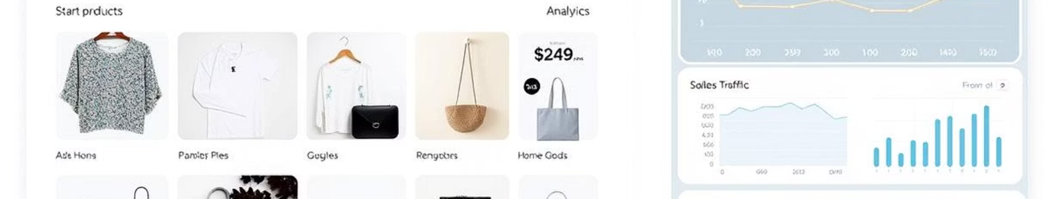
Project Motivation and Objectives
Bridge the Gap
Affordable Marketplace
Connect small manufacturers with digital consumers.
Offer unique products at competitive prices.
Admin Analytics
Seamless Shopping
Enable order and product analytics for business growth.
Provide secure login, cart, and payment simulation.

Slide 3
Challenges in Existing E-Commerce Systems
High Barriers
Limited Visibility
Restricted Access
High entry fees for small vendors
Small brands lack identity
Analytics only for premium sellers
Algorithmic favoritism for large sellers
Generic product saturation
High logistical costs

Slide 4





MercatoHub’s Solution and Features
Zero-Cost Listings
Cloud Hosting
Secure Authentication
No fees for small vendors.
Efficient media management with Cloudinary.
Firebase for user and admin roles.
Payment Gateway
Safe checkout simulation using Stripe.

Slide 5




System Architecture Overview
Frontend
Backend
React, Vite, TypeScript for UI.
1
2
Node.js, Express, RESTful APIs.
External Services
Database
Firebase, Cloudinary, Redis integration.
4
3
MongoDB for unstructured data.

Slide 6
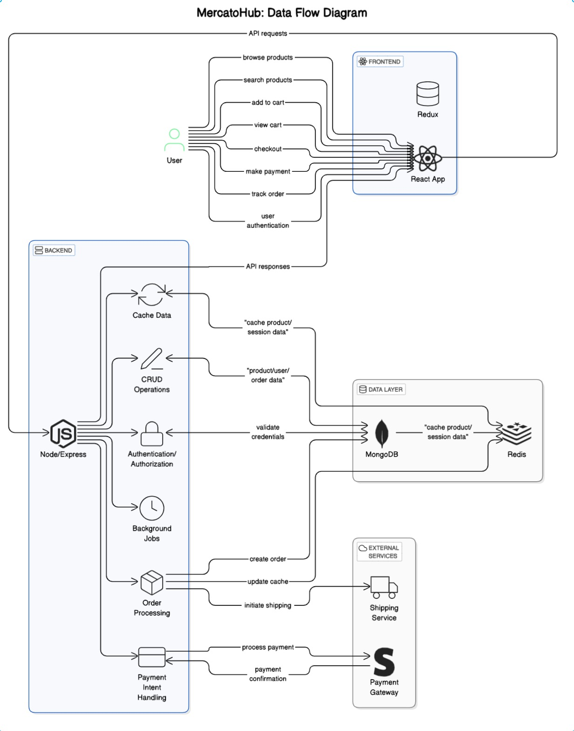

Slide 7
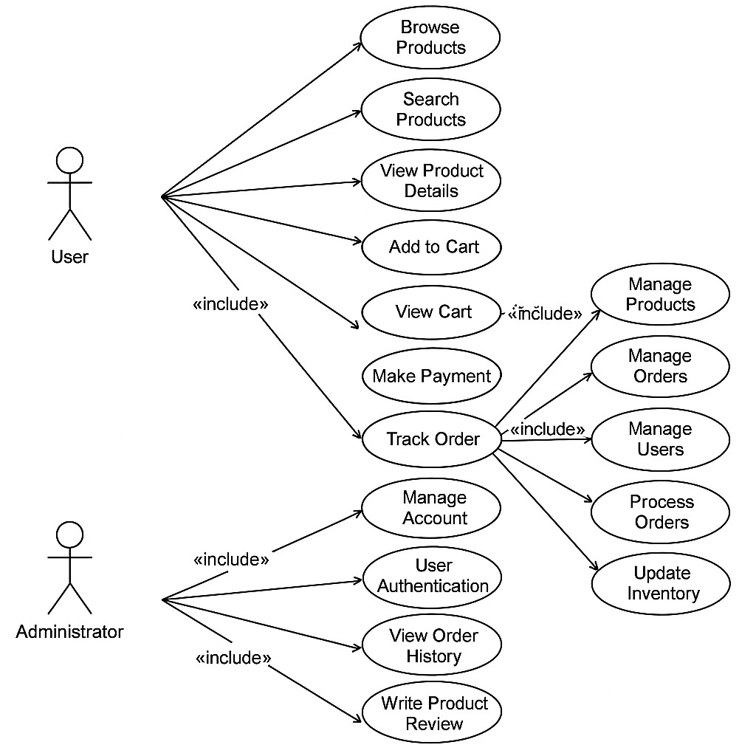
User and Admin functionalities

Slide 8
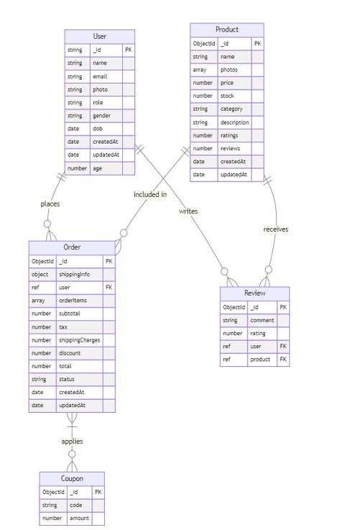
Database Design

Slide 9
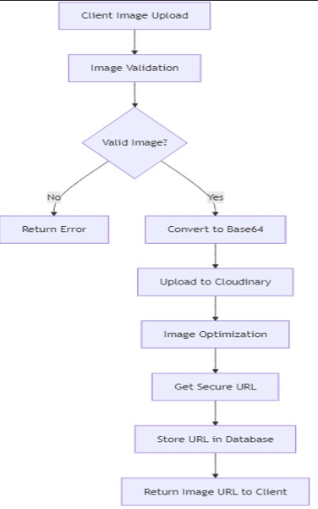
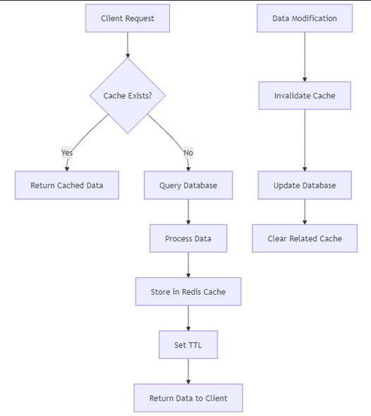
Cloudinary Image
Management
Redis Caching
System

Slide 10
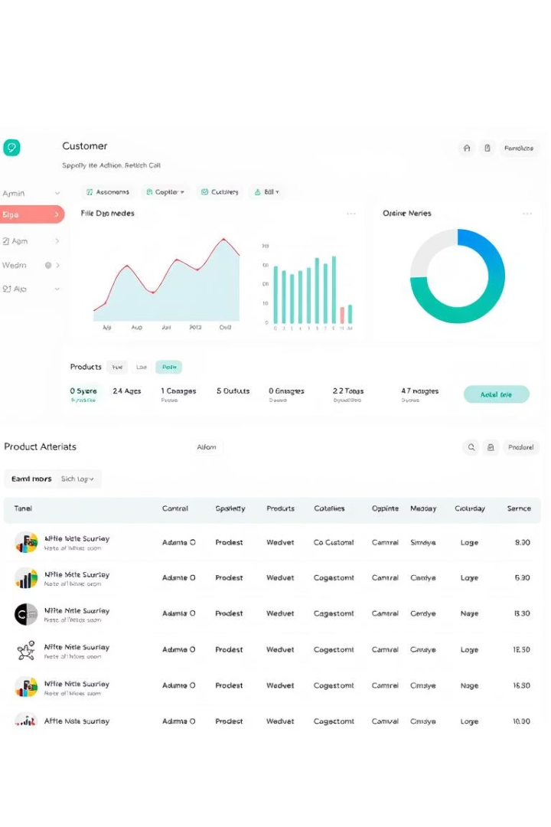
Implementation Highlights
User Experience
Admin Dashboard
Responsive UI, product carousel, and real-time cart.
Live analytics, inventory, and order management.
State Management
Redux and RTK Query for data flow and caching.

Slide 11

Testing and Results
1
Functional Testing
All core features passed.
2
Integration Testing
Modules worked seamlessly together.
3
User Acceptance
User Sign In /Sign Up and Orders successfully working.
4
Performance
Fast response, optimized images, and robust sessions.

Slide 12

Conclusion and Future Scope
Empowered Small Businesses
MercatoHub is trying to bridge the digital divide.
Scalable Architecture
Ready for real-world deployment and growth.
Future Enhancements
More Payment Options and advanced analytics possible.

Slide 13
Thank You

